Slide 1
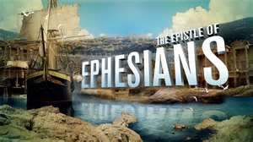

Slide 2
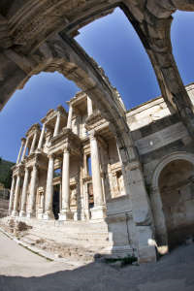
Ephesians
Written by Paul
60 A.D., while in Rome
Written to the Ephesians, but since it doesn’t have the usual greetings, he might have meant for it to be circulated to other churches as well.
Purpose of book:
Paul demonstrates that Baptism unites all Christians
Lutheran theologians express the gospel by three phrases: by grace, through faith, on account of Christ. But some may view faith as a work of the believer. Paul, in Ephesians, corrects this view, stating clearly: “For it is by grace that you have been saved, through faith—and this not from yourselves, it is the gift of God—not by works, so that no one can boast.” (2:8-9)

Slide 3
Message
Paul doesn’t call the Ephesians out on any particular error or heresy
He wanted to expand the horizons of his readers
Wanted them to better understand God’s eternal purpose and grace; appreciate high goals God has for his church on earth
How to fulfill these goals?
God has reconciled individuals to himself as an act of grace
God has reconciled these saved individuals to each other
God has united these individuals into one body, the church

Slide 4
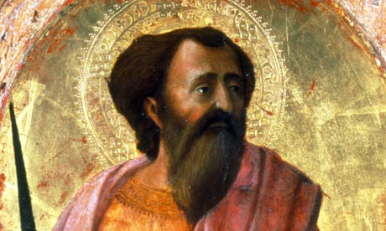
God intends for the church that it be the means by which He displays his “manifold wisdom” to the “rulers and authorities in the heavenly realms”. Christian existence is not merely on an earthly plane. It receives its meaning and significance from heaven, where Christ is exalted at the right hand of God. However, it is the life here on earth where we, the people, work out the purposes of God. And that is why he gave gifts to the members of the church, so we can minister to one another and to all humanity.

Slide 5
Themes
Law Themes: Rivalry between believers; grieving the Spirit through unfaithfulness; marital unfaithfulness; spiritual warfare
Gospel Themes: Baptism; election by God’s grace; justification by grace alone; the mystery of Christ revealed; unity in Christ’s Body

Slide 6
History
Paul had been in Ephesus for about three years (according to Acts 18 – 20).
Preached to large crowds
Complaints about him
He barely escaped a huge mob at the theater here
A port city in the province of Asia
One of the “jewels” of the Roman empire
Commercial center
No city in Asia was more famous or more populous
Ranked with Rome, Corinth, Antioch, and Alexandria as among the foremost urban centers of the empire
Huge temple to Artemis (Diana)—one of the Seven Wonders of the Ancient World

Slide 7
