Slide 1
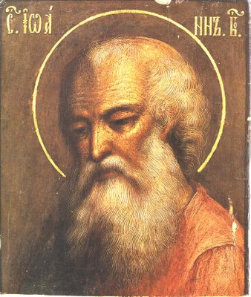
I, II, III John
Johannine Epistles

Slide 2
Just the Facts…
Author: John, apostle and evangelist, now called “the elder”
Date: 85 – 95
Difficulty in dating it for sure
Many speculate this was written after the gospel
Did you know that this John is Jesus’ cousin, too?
(Mothers were sisters: Mary, and Salome)
See http://www.keyway.ca/htm2004/20041022.htm
Purpose: To establish and encourage the faith of John’s contemporaries in the wake of rising controversy because some had left Christian congregations or had troubled them.
Help combat Gnosticism (“Spirit is entirely good; matter is entirely evil.”)

Slide 3
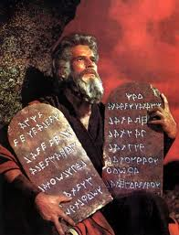
Law Themes
Sin
Walking in darkness or light
God’s commands
Hatred
Death
Deceit
Antichrists
Love one another
Lawlessness
Deceivers
Wicked works
Imitate God, not evil

Slide 4
Gospel Themes
Christ, the atoning sacrifice
Our advocate
Eternal life
God perfects His love in us (sanctification)
Light
Born of God
Children of God
Truth
Fellowship
Reward
Abiding in Christ’s teachings
Christ has come in the flesh

Slide 5
Similar phrases and expressions between the epistles and gospel of John
I John | Gospel of John
1:1 | 1:1, 14
1:4 | 16:24
1:6 - 7 | 3:19 - 21
2:7 | 13:34 - 35
3:8 | 8:44
3:14 | 5:24
4:6 | 8:47
4:9 | 1:14, 18; 3:16
5:9 | 5:32, 37
5:12 | 3:36

Slide 6
John and 1 John Comparison
JOHN | 1 JOHN
John’s purpose is given in John 20:31:"But these (things) are written, that ye might BELIEVE that Jesus is the Christ, the Son of God; and that believing ye might have life." | John’s purpose is given in 1 John 5:13:"These things have I written unto you that believe on the name of the Son of God; that ye may KNOW that you have eternal life."
Written to all the world (a good book to recommend to an unsaved person) | Written to believers (a good book to recommend to a saved person, especially a new believer)
Written in order that people might believe and have life (20:31) | Written in order that believers might know that they have life (5:12-13).
Written so that people might be saved | Written so that saved people might have assurance of salvation
Written so that people might come to the Father (John 10:9; 14:6) | Written so that believers might be at home in the Father’s house and enjoy His fellowship (1 John 1:3; 3:1)
Written so that the dead might have life (John 5:24) | Written so that the living might know they are alive (1 John 3:14) and that they might show forth and express this life

