Slide 2
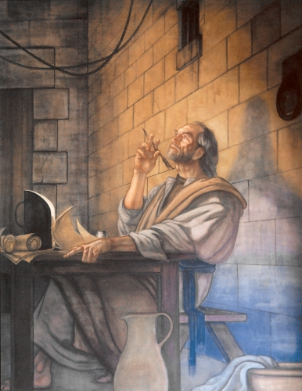
Philippians
“The Letter of Joy!”
Written by Paul
While in prison in Rome
60 AD
Purpose of book:
Paul describes a life worthy of the Gospel (1:27)
To thank the Philippians for the gifts they had sent (when they learned he was in prison)
To report on how he’s doing
“Stand firm” in the face of persecution
Exhort them to humility and unity

Slide 3
Characteristics
1. No O.T. quotations
2. A missionary thank-you letter; progress report
3. Manifests a particularly vigorous type of Christian living
Self-humbling
Pressing toward the goal
Lack of anxiety
Ability to do all things
4. Outstanding; the NT letter of “joy” (14x)
5. Contains one of the most profound Christological passages in the NT (2:5-11), but he uses it for illustrative purposes

Slide 4
Themes
Law Themes: Suffering, uncertainty, and personal sacrifice; rivalry over the Gospel; growth in humility and right-mindedness
Gospel Themes: Joy in Christ; Jesus’ exaltation after the cross; righteousness through faith in Christ; heavenly citizenship

Slide 5
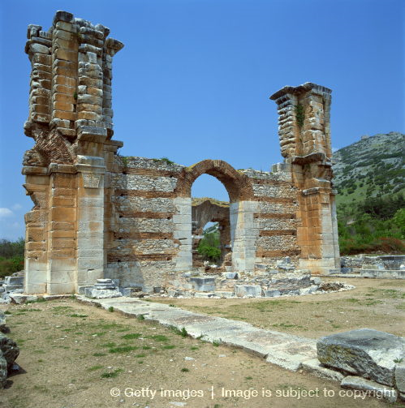
History
Philippi was a Roman colony in Macedonia, located on the main highway leading from the eastern provinces to Rome
The Via Egnatia
Bisected the city → came through the Forum → brought lots of wealth
Gold-producing region
Named after Alexander’s father (Philip II)
Even though a colony, it gained honors and enjoyed rights legally equivalent to those of Italian cities

